Slide 1

Supply Chain Finance
On Blockchain
Notes:
4

Slide 2
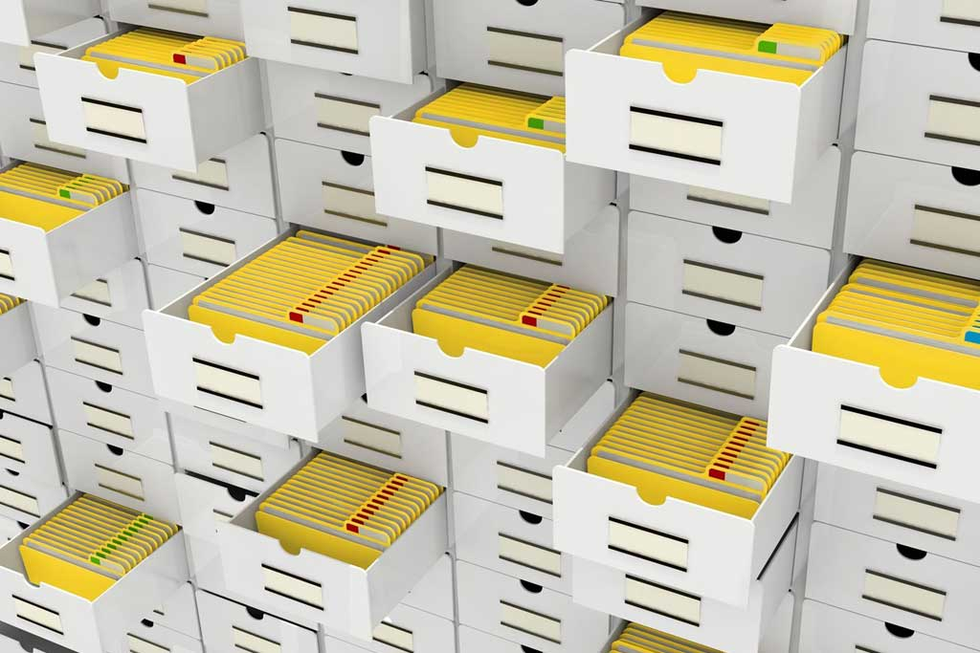



Problem Statement
Traditional supply chain Financing solutions pose the following problems
Management and storage of hard copies and paper is a daunting task.
Maker and buyer both have to manage and sift through a large number of documents to complete a transaction.
The time it takes to transport documents makes the traditional process extremely time consuming and reduces the speed of business.
Current systems have room for buffers making the process stringent and inflexible.

Slide 3
Supply Chain Finance
IPDC Maker fills KYC Form
KYC FIlled
IPDC Checker Approves KYC Form
KYC Approved
Admin assigns maker and checker
Buyer / Seller Appoints Admin
Admin Appointed
Checker and maker assigned
Buyer maker issues Purchase order
Buyer checker approves/ decline PO
PO Issued
PO Decision made
Buyer Maker Accepts/Rejects Challan
Seller Maker issues challan, Checker approves/ Declines
Challan Issued
Online Consent Requested
Seller Maker raises invoice checker Approves/ Rejects
Buyer Maker Accepts/Rejects Invoice
Invoice Raised

Slide 4


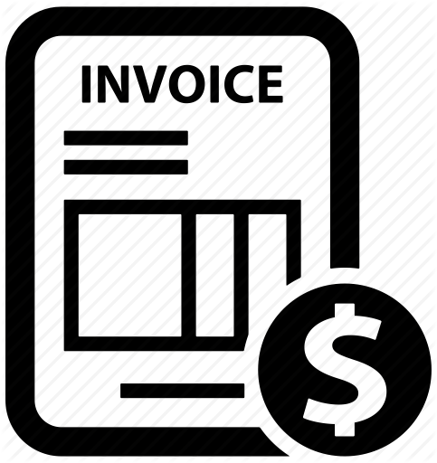
Features Of Supply Chain Finance
Capability to produce System Generated Work Order, Distributing Order
On-line Issue of PO, Challan, Invoice
On-line Verification
Capability to check Balance, IPDC Limit
Overdue Invoices checking
Check customer account info Online
Online addition and deletion of customers and Suppliers/ Distributors

Slide 5



Benefits of Supply Chain Finance
Time and Resources Saving
Save time and resources by completing transactions online
New financial opportunities for sellers through financial institutions
Transparency by capability to check account status balances online anytime
Multiple Steps of authentication by checking after each issue of challan, PO
SCF
Financing
Opportunities
Transparency

Slide 6
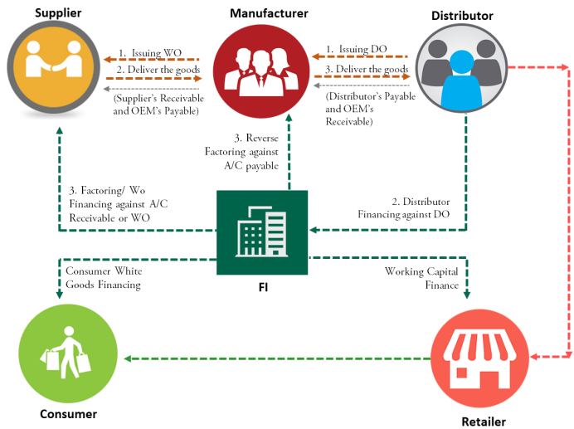
Financing
Through
SCF System

Slide 7
Roadmap
Fund Requisition And Invoice Payment
20th June
Invoices And FY Limit
25th May
PO And Challan Issue
5th May
KYC Form Filling
29th April
Maker Checker Concept and IPDC Creation
15th April
Start of Supply Chain Finance
1st April

Slide 8
Revenue Model

Slide 9

THANK YOU
Notes:
4

